Slide 1


NOVA INITIA
Final Demo/ SPRING 2021

Slide 2

TEAM
Scrum Master : Sarai Toloza
Lead User Interface: Emily Nunez
Lead Data Analyst: Yara Alrashidi
Lead Machine Learning: Hailey DeNys
Lead Blender Designer: Jacob Gattuso

Slide 3

Project Description
Rhinoplasty: complex, nasal plastic surgery procedure
Nova Initia uses a machine learning algorithm and 3D imaging tool
3D imaging tool → Blender
Algorithm → outputs options based on patient facial structure
Database → created by using existing web application
Facial Scanner → Bellus3D
Notes:
Rhinoplasty surgery is a plastic surgery procedure that has to do with the nose.
It is considered to be one of the most complex cosmetic surgeries because of its uncertainty.
Therefore, plastic surgeons need to use modern-day technology to assist them in conducting such procedure.
Nova Initia is an application that uses a combination of a machine learning algorithm and a 3D imaging tool
which aids in the preoperative stage of a rhinoplasty procedure.
Today we will be presenting a machine learning algorithm that displays nose options for patients based
on the patients’ facial structure and the 3D imaging tool we use is Blender.
Our system uses an existing web application that helped us create our database of faces.
Nova Initia takes in a JSON file and outputs facial scans for the patient to choose from.
These facial scans are taken using the Bellus3D iPhone application.

Slide 4
User Process
Scan face in the Bellus3D application
Export .obj folder
Start Nova Initia
Upload the .mtl, .jpeg, and .obj files into the web app
Manually plot points onto the patient’s scan
Upload JSON file onto the computer
Choose the current patient
See options displayed
Choose preferred nose
See preferred nose on current patient’s face in Blender

Slide 5


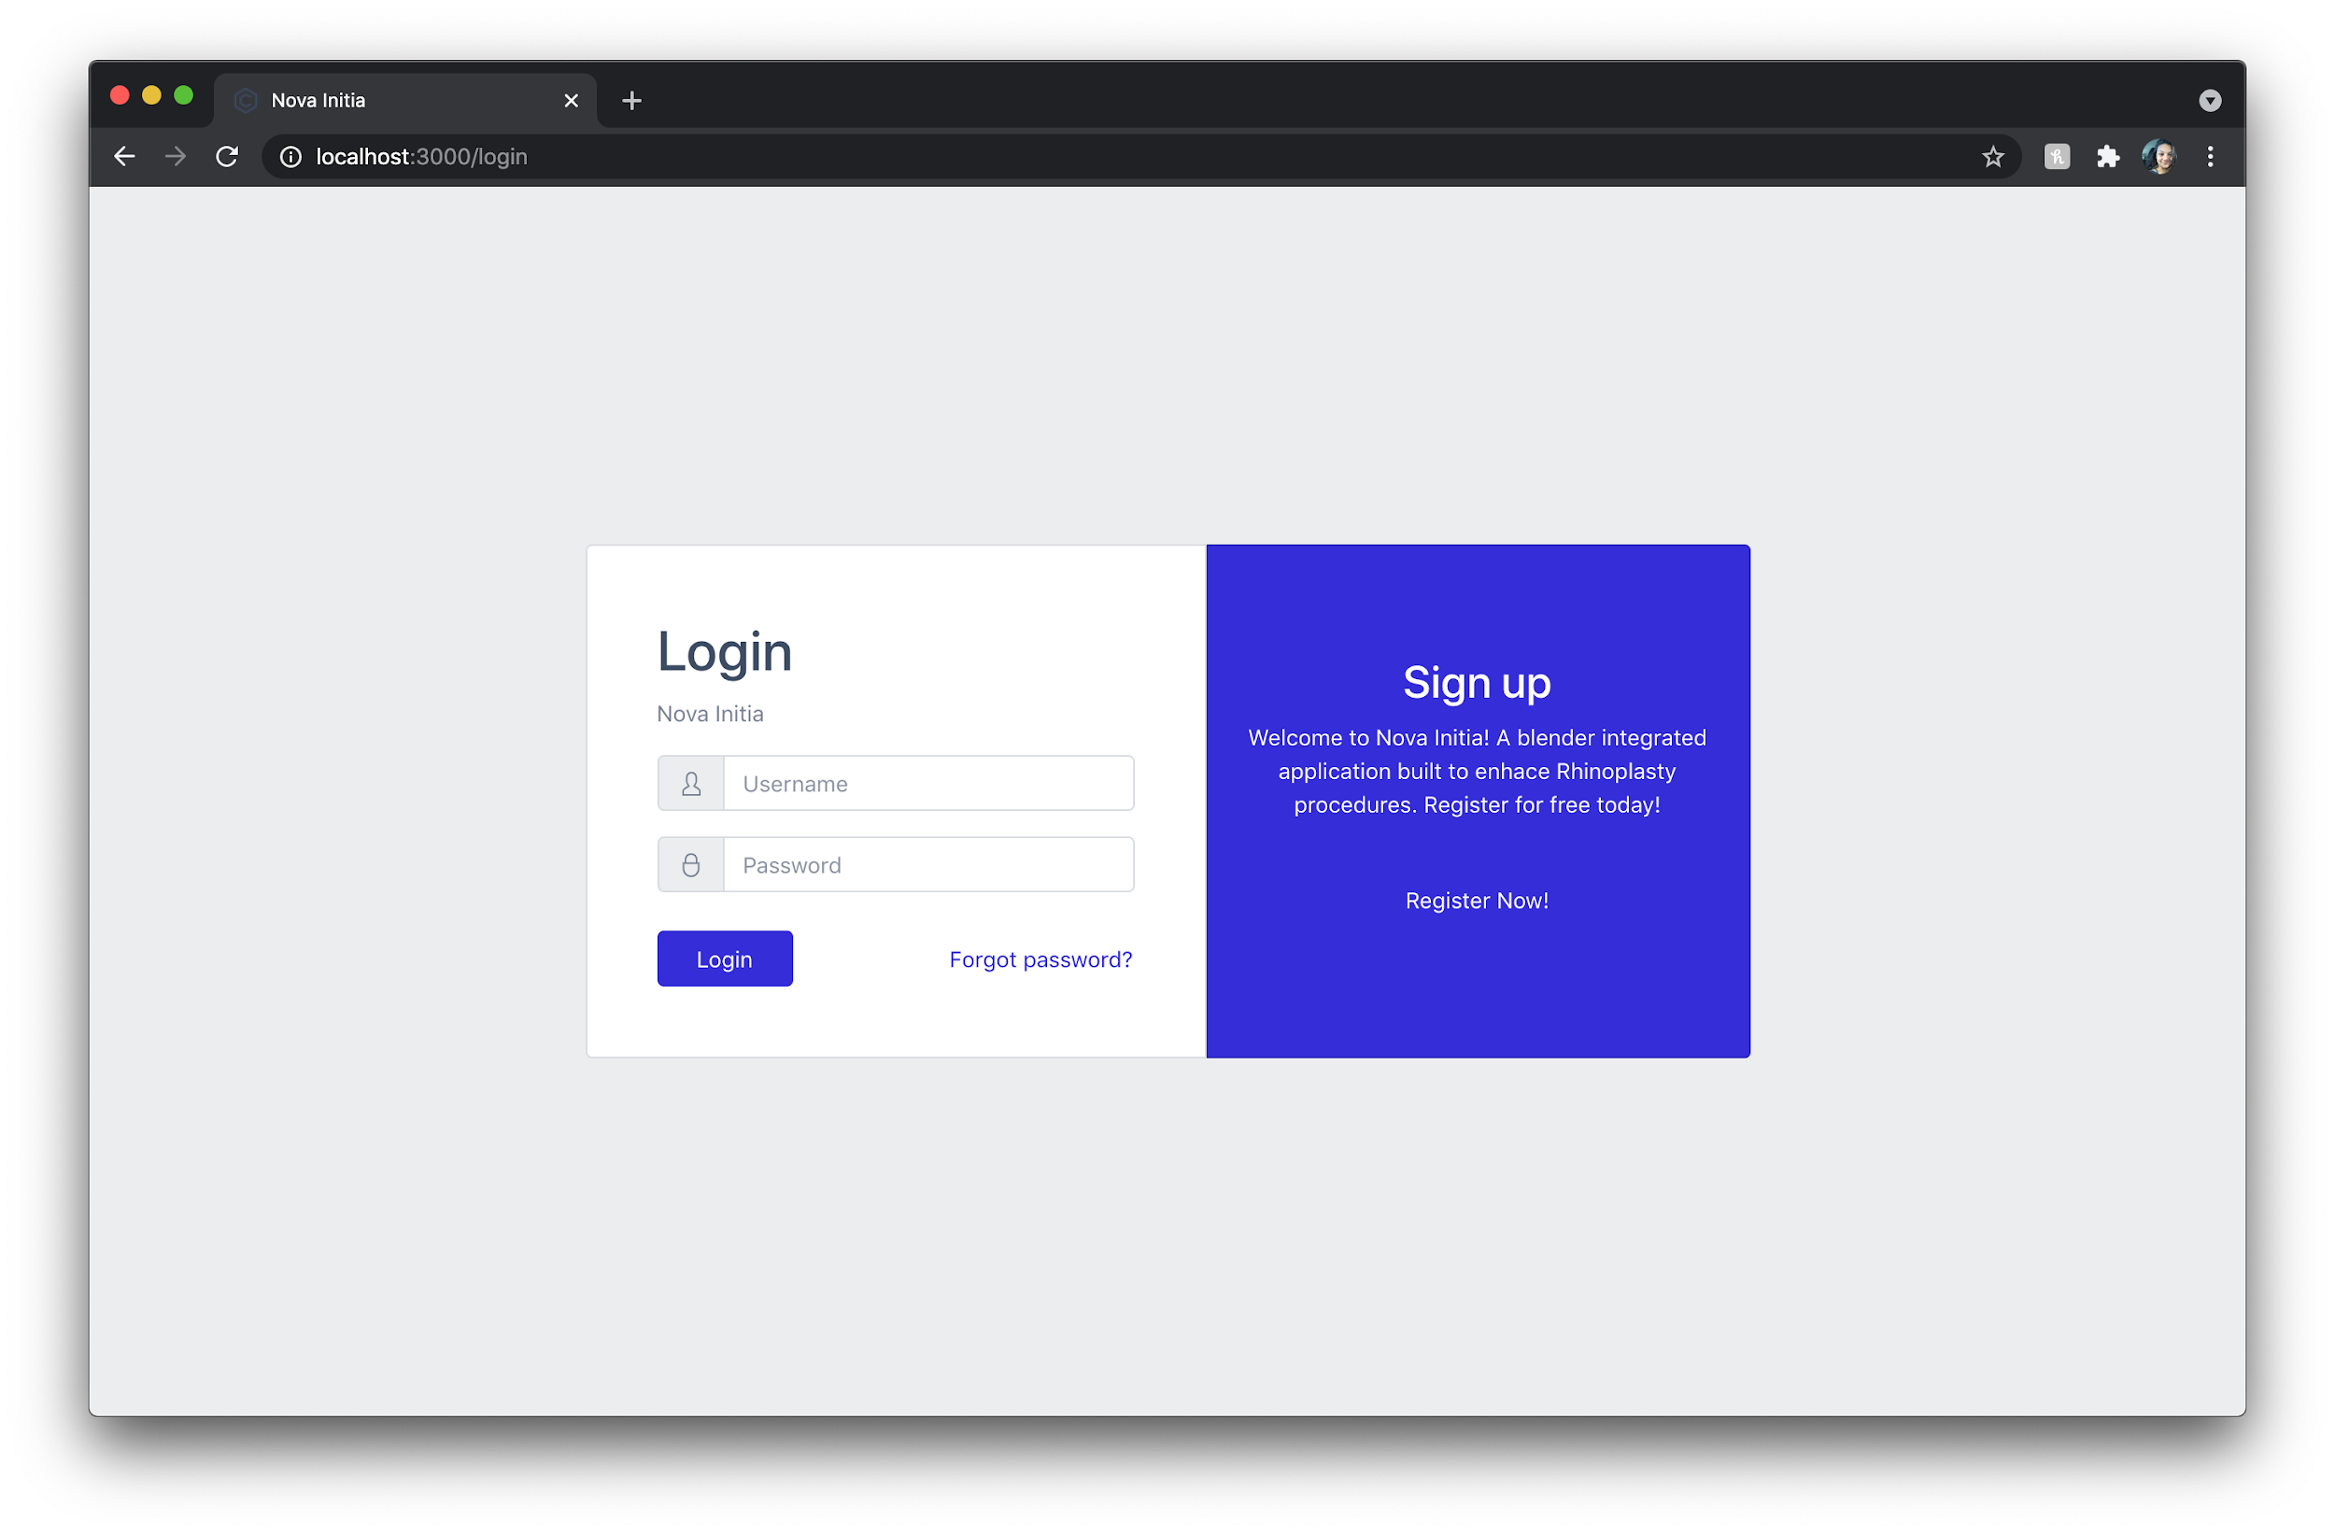
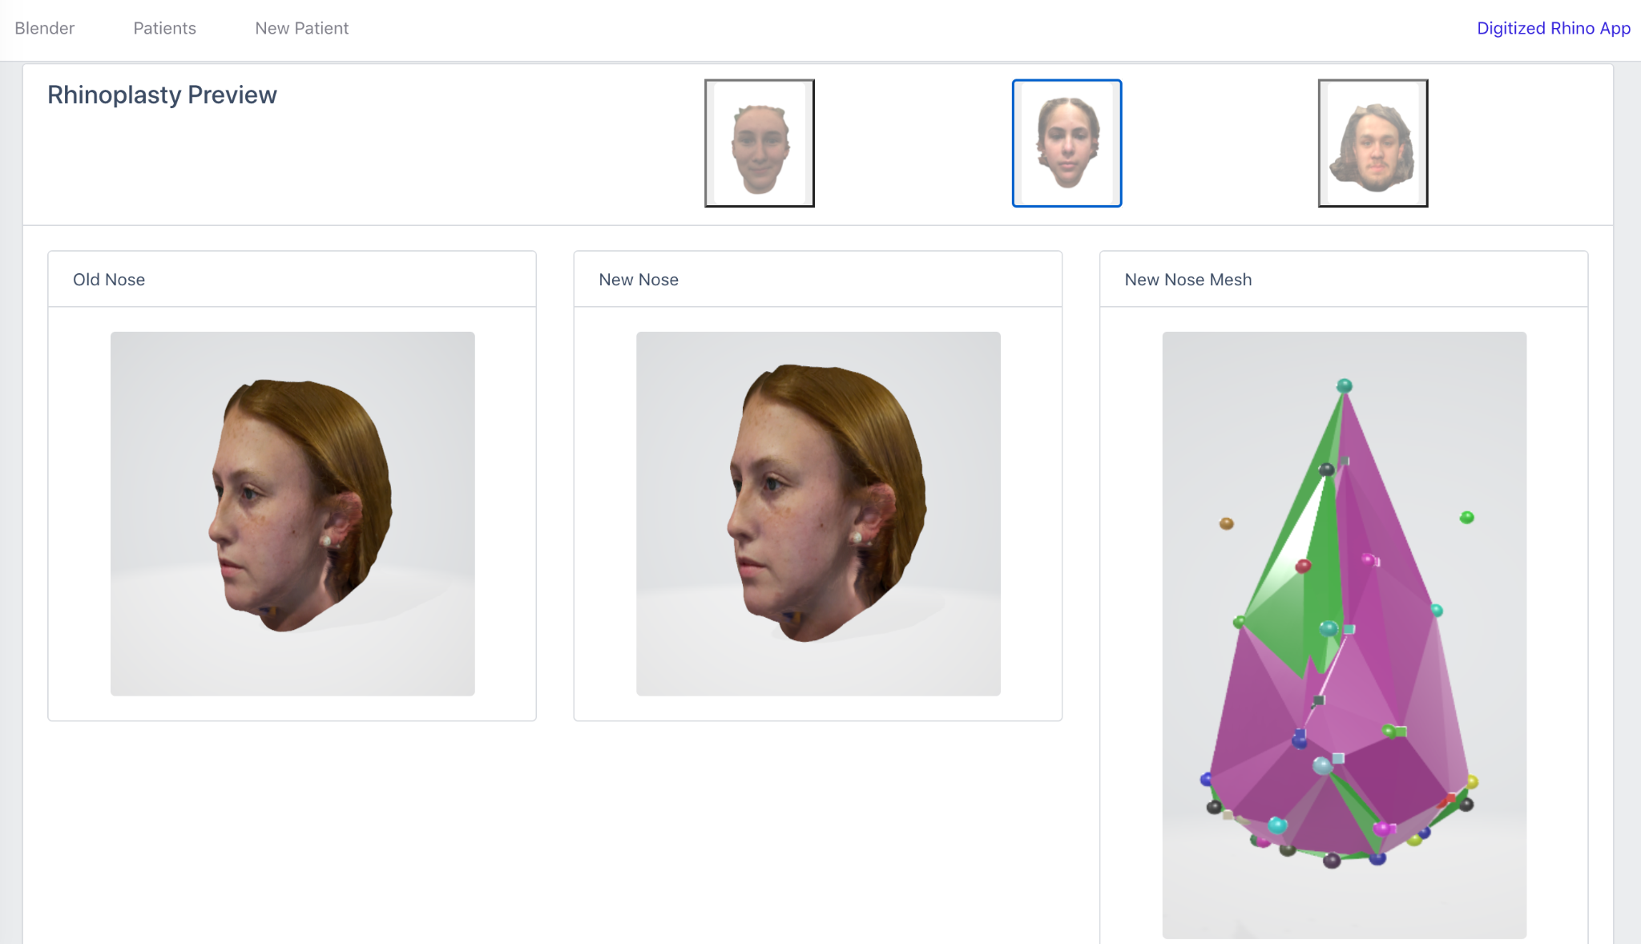
User Interface
Single Page React Application -- Dockerized
Connectivity to Digitized Rhinoplasty Web Application
Backend Server: axios and express for user authentication and data transfer
Bootstrapped with CoreUI template for mobility
Scenes for 3D images
Notes:
Why Docker? Once docker is deployed, it will automatically install all dependencies for the user to continue development on their own. This will allow for continuous enhancement on the application from other engineers post graduation. This container will include images such as the build file for ./src, mySQL, Blender and it will run on a linux environment for unanimity of any future dependencies

Slide 6
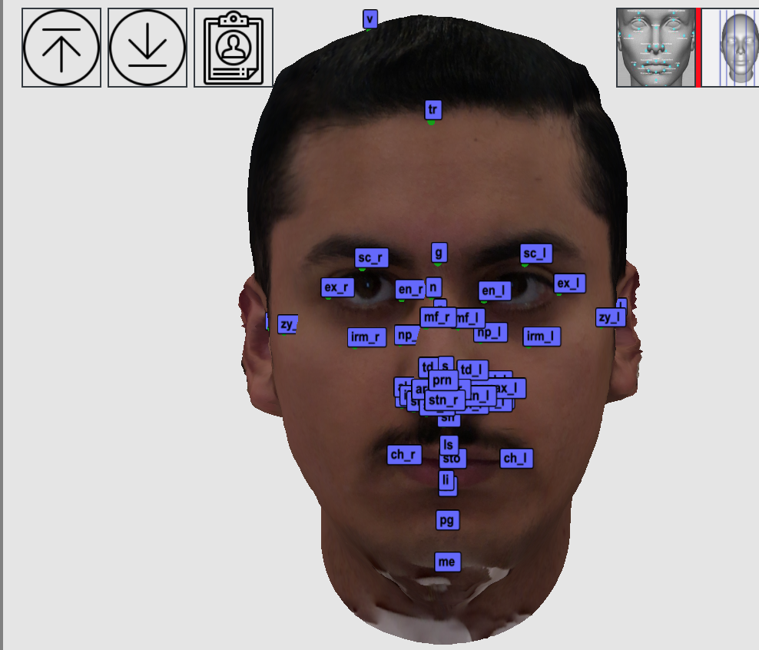
Database
33 volunteers
Scanned faces using Bellus3D application
Export object folder
Upload folder in digitized web application
Manually plot points
Export JSON
Notes:
The desired database would be having face scans of people that have had a successful rhinoplasty in the past. However, due to the limitation of not having access to that, the database we created is using 33 people that volunteered to be part of our project and have signed a consent form. Each person went through the stage of getting their face scanned using the Bellus3D phone application by one of our team members then their object type folder gets exported. Each object folder has three files which include a .obj, .mtl, and a jpeg of their scan. This folder is then used by myself in the digitized web application provided to us, I first upload each of the three files and then the person’s scan is displayed. I then manually plotted 48 points onto each person’s scan and then I download the JSON file to my computer. The JSON files are then used in the read_in code which will generate a CSV and an XLSX file for each person. These files make up our database, which include the measurements and face obj folder for each person. The XLSX files are used for Blender and the user interface uses the .mtl and .obj files. The patient on the right here is patient Bader and this is an example of the 48 points plotted onto Bader’s face scan.

Slide 7
Database
ac_l | 17.74 | -18.15 | 91.4
ac_r | -16.54 | -17.53 | 92.08
armax_l | 12.44 | -13.77 | 105.54
armax_r | -9.59 | -14.04 | 111.5
al_l | 18.39 | -10.95 | 89.51
al_r | -16.88 | -13.46 | 94.08
stn_l | 8.09 | -16.67 | 109.63
stn_r | -4.54 | -18.2 | 114.3
ch_l | 25.08 | -41.95 | 86.77
ch_r | -19.78 | -40.3 | 90.56
en_l | 16.62 | 25.01 | 80.65
en_r | -16.83 | 25.52 | 81.54
ex_l | 47.48 | 28.4 | 70.99
ex_r | -46.99 | 26.64 | 74.58
g | -2.17 | 39.43 | 96.7
li | 0.68 | -50.06 | 95.73
ls | 1.1 | -36.05 | 100.25
mf_l | 5.38 | 13.54 | 99.24
mf_r | -6.45 | 13.78 | 103.58
me | -0.92 | -82.92 | 88.87
irm_l | 34.76 | 6.72 | 76.32
irm_r | -36.24 | 6.41 | 76.27
np_l | 14.56 | 8.24 | 87.69
np_r | -17 | 7.16 | 87.51
n | -4.36 | 25.77 | 96.05
pg | -0.39 | -66.24 | 89.6
itn_l | 15.78 | -16.41 | 98.87
itn_r | -14.45 | -16.68 | 100.13
prn | -3.05 | -10.51 | 117.07
r | -1.29 | 17.01 | 102.59
sto | 0.9 | -41.29 | 99.13
sbal_l | 12.01 | -19.08 | 100.63
sbal_r | -11.73 | -18.91 | 101.62
sl | 0.65 | -52.5 | 95.42
sn_l | 6.9 | -19.92 | 105.63
sn_r | -6.76 | -20.5 | 107.58
Notes:
The table you see here is the XLSX file that Blender uses which includes all 48 points, the table here is shown into three sections and shows an example of 36 of the 48 points. The information saved are the shortened name of each point and the corresponding location of each point on the face which are the x, y, and z coordinates. These 48 points will help calculate distances which will be used in ratio calculations that are going to be explained by Hailey.

Slide 8

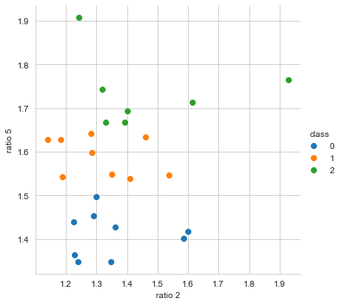
K-NN MACHINE LEARNING ALGORITHM
k-NN algorithm is triggered - match_faces.py
3 Classes
5 Ratios
Euclidean Distance
Notes:
This semester I developed a k-NN machine learning algorithm in python to find matching faces. Our vision was to use a database of “nice noses” to match the patient with a person from the database based on their facial structure. The nose from the matching face then replaces the current patient’s nose.
k-nn stands for k nearest neighbors, this type of ML is considered lazy learning since the learning is done once it is run using labeled data. Basically the algorithm uses the Euclidean distance between the current patients face and the database to predict which class a face would be classified as by looking at the k nearest neighbors.
I separated the faces into 3 groups based on their cross ratios. The graph on the right shows each of the faces from the database plotted using ratio 2 and 5 and the colors represent which class the face is in.

Slide 9
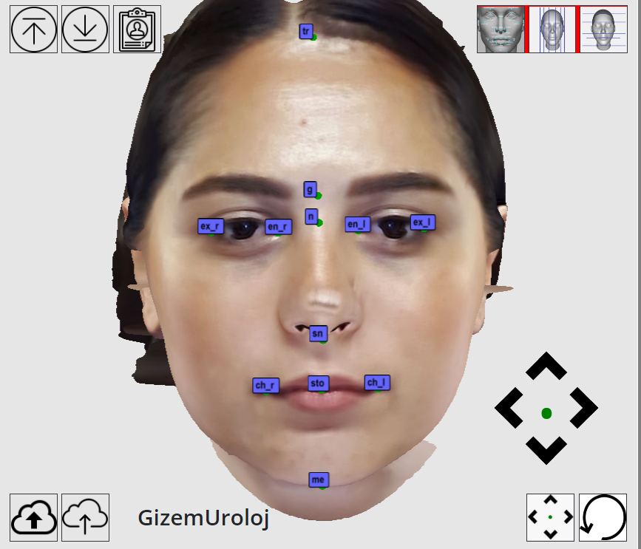
Ratios
Horizontal Ratios:
intercanthal/interchillion
ex_r - ex_l / ch_r-ch_l (red)
interchilion/interdacryon (ratio 2)
ch_r-ch_l / en_r-en_l (orange)
Vertical Ratios:
forehead height/stomion-soft menton
tr-g /sto-me (green)
Soft menton-nasion/subnasale-stomion
g-n / sn-sto (blue)
Cross Ratio:
trichion-menton/zygions (ratio 5)
tr-me / zy_l-zy_r (purple)
Notes:
After researching I chose 5 facial ratios to compare each face, after checking how defining each ratio was, I found that the two most defining ratios were the interchilion/interdacryon (ratio 2) and trichion-menton/zygion (ratio 5) ratios.

Slide 10
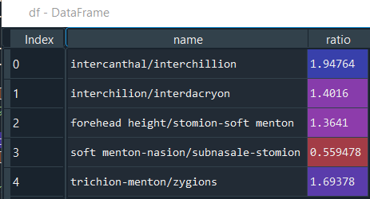
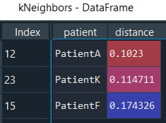
K-NN MACHINE LEARNING ALGORITHM
Nearest neighbors dataframe for PatientE
Ratio dataframe for patient Gizem Urolog
Notes:
With those ratios chosen, my algorithm has 80% accuracy in predicting what class a face goes to.
Since the purpose of our algorithm is to find matching faces, the classifications don’t necessarily play a role in what we were trying to accomplish but it does tell us that the ratios chosen are good to use when finding a match
When the algorithm is run, it reads in the patients JSON file and pulls the needed facial points seen in the previous slide, then outputs the 3 closest matching faces based on the Euclidean distance using ratios 2 and 5. The patient is then able to choose which nose they like the best from the 3 choices and that face is sent to blender.

Slide 11
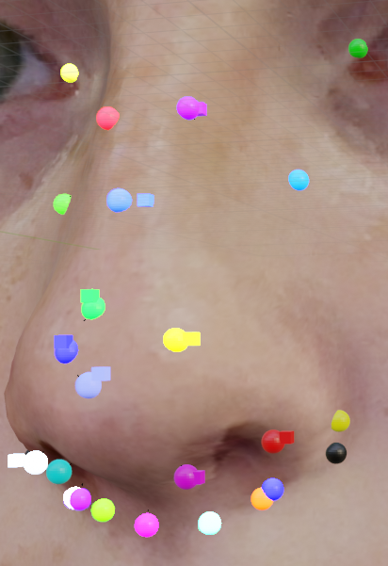
Adding Points to Blender
Blender takes in the original and the new nose points created by the rule based algorithm
Old and new points are displayed on the 3D model with spheres and cubes respectively
User matches sphere to cube of same color with the deform tool
Nose With Points

Slide 12
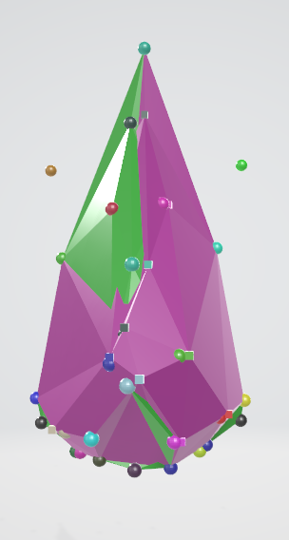
Blender
Blender makes two simple meshes
The Green mesh shows the simple mesh of the before nose
The Pink mesh shows the adjustment that the algorithm makes
This shows the user a simple visual representation on how much the nose will be adjusted
Notes:
Along with previous semester 3d face manipulation there is a new addition
The application now makes a simple mesh of the nose
Two meshes are made, one created from the old points of the nose and one of the new points of the nose
This way the user will be able to see how much the nose will be adjusted in simpler terms

Slide 13
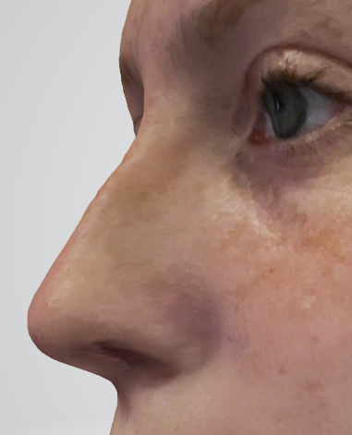
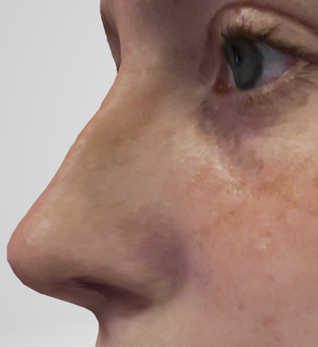
Before
After

Slide 14
Final Demo
https://youtu.be/sHAIdkmtqew

Slide 15

Thank You!

